Slide 1
Developing Student-Run Businesses as a Stepping Stone to Employer-Paid Jobs
Presented By: Corey Fineran & Lindsay Zerull
Transition Curriculum Inc.
NextUp Transition Curriculum

Slide 2
What is a student-run business?
A micro-enterprise within the school building or classroom that provides an entrepreneurial experience for students developing transition skills needed for post-secondary employment and living.
Why should schools create this opportunity for students?
Increases labor force participation
Enhancement of students’ understanding and engagement.
Skill development (soft skills, hard skills, communication, self-determination)

Slide 3
Examples of Student-Run Businesses
Products
Themed Clothing
Coffee Shop
Food Items
Greeting Cards
Handmade Products
Agriculture (Flowers or Plants)
Digital Products
Services
Recycling
Copying
Cleaning/Laundering
School Events
Notes:
School events – ticketing, general assistance ?

Slide 4
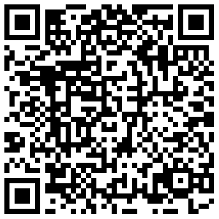
Evaluate
Research business ideas
Identify the target market
Determine the internal strengths/weaknesses and the external opportunities and threats
Determine start-up costs
Evaluate students’ ability and determine supports
Analyze environmental and location factors
NextUp Student-Run
Business Set-Up

Slide 5
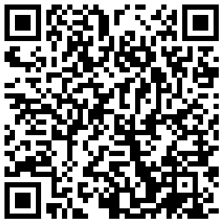
Sample SWOT Analysis

Slide 6
Support
Who is your support?
Be prepared
Show how this student-run business makes a difference
Highlight how this will benefit the students, staff, school, and community
If funding is needed, have a plan

Slide 7
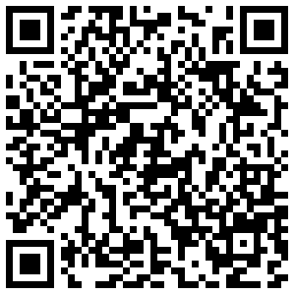
Business Plan
Description of business
Detailed description of product or service
Location and equipment needed
Pricing and marketing tactics
Financial projections
Notes:
Added – financial projections

Slide 8
Determine Roles
Create a job description
Develop task lists
Applications and interviews for positions

Slide 9
Market
Create flyers and posters
Email advertisements with infographics and promotions
Advertise through school announcements or newsletters
Social Media
School or local media

Slide 10
Teaching Opportunities
Incorporate instruction on pre-employment and on-the-job topics.
Develop social skills lessons
Develop math lessons
Align behavior goals and social-emotional lessons with student-business expectations
Notes:
Added “interviews”

Slide 11
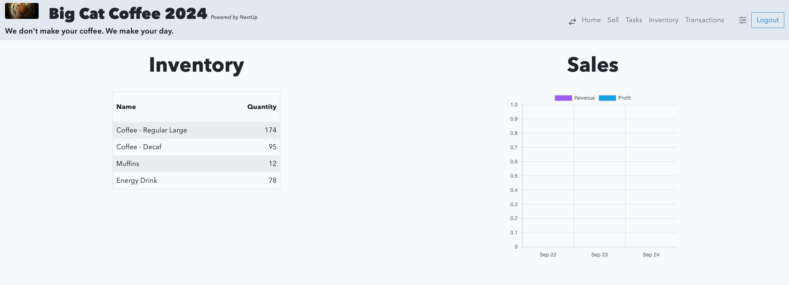
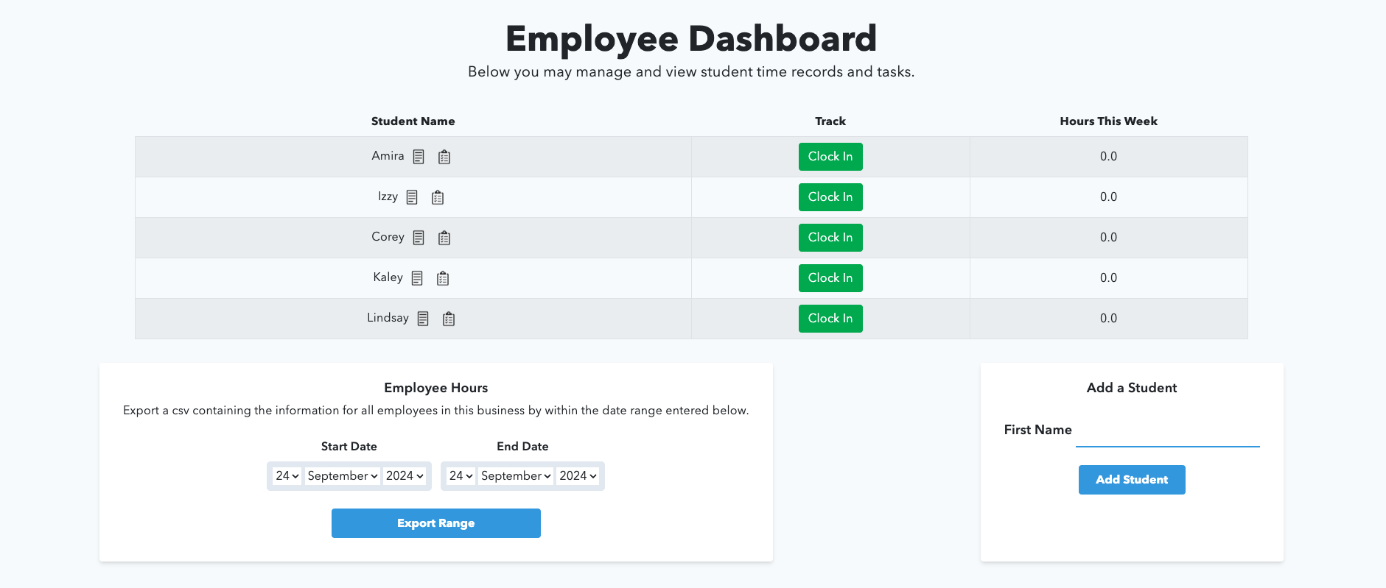

Slide 12
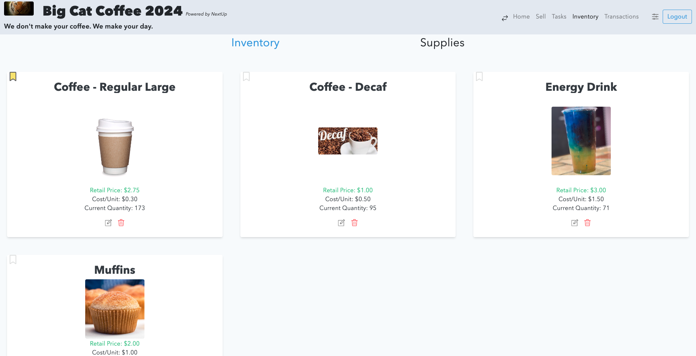

Slide 13
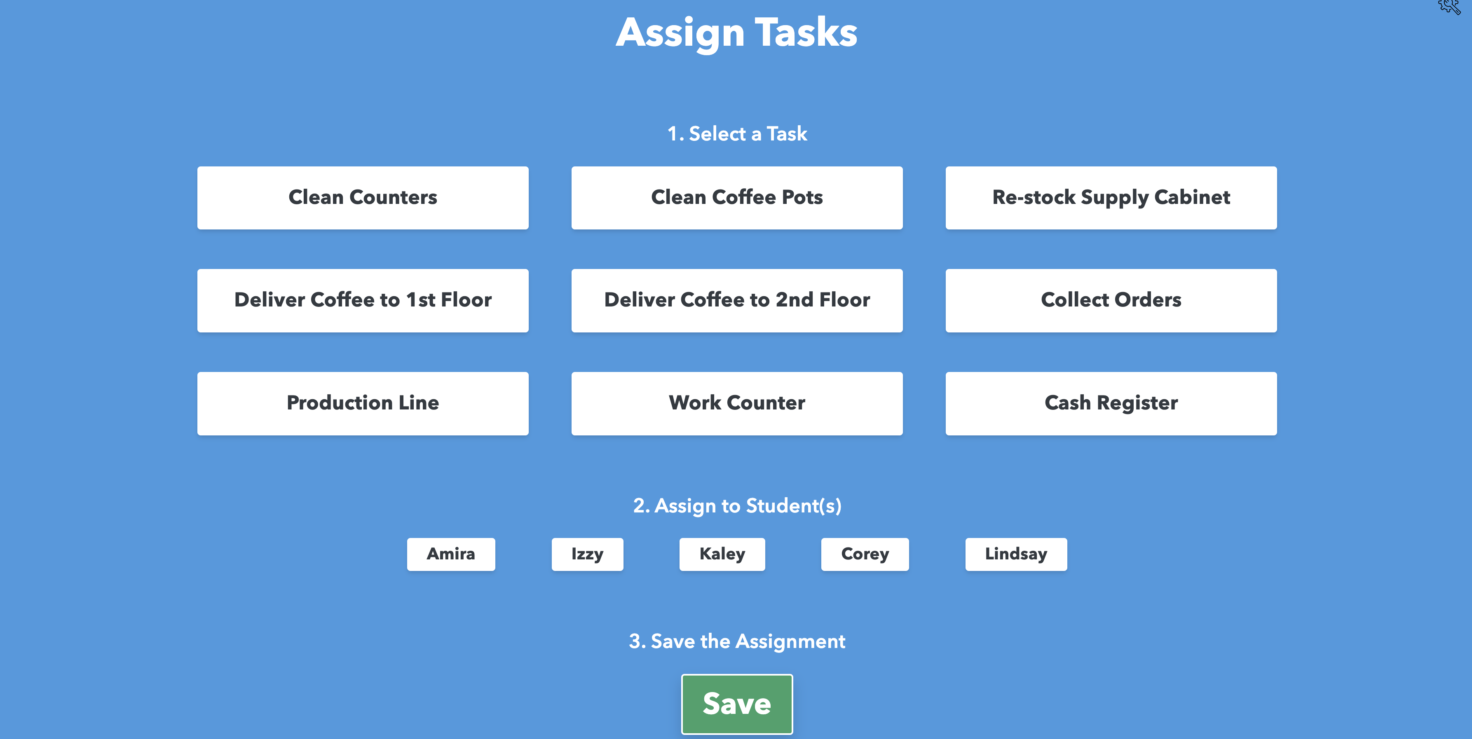
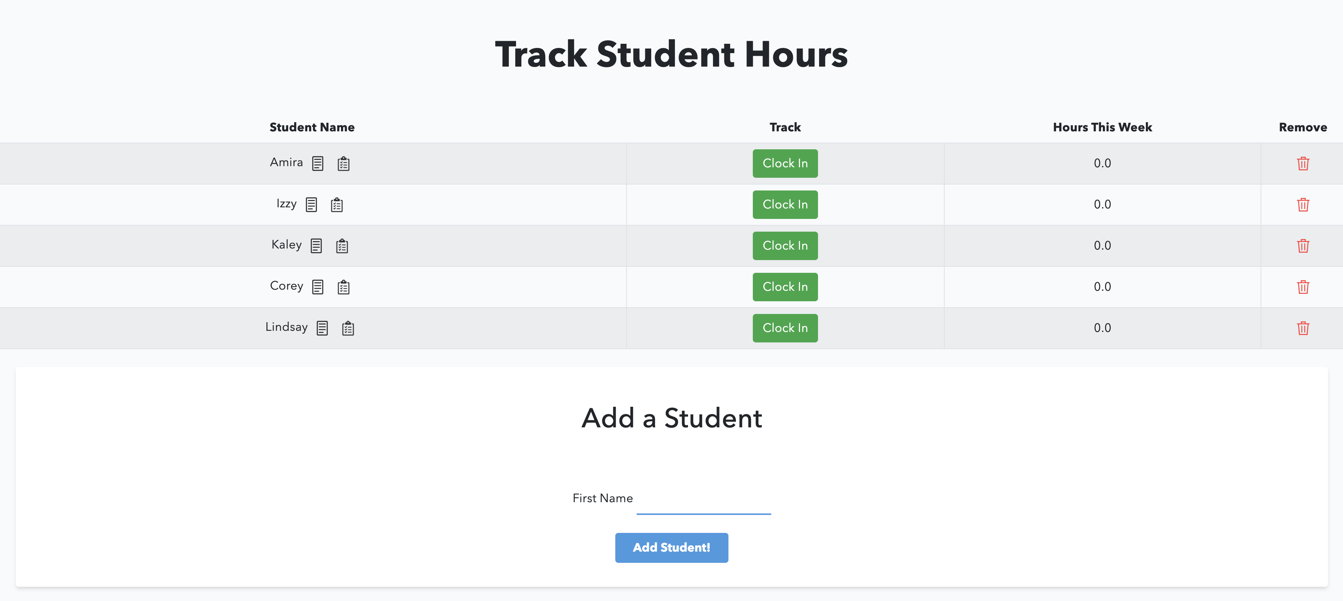

Slide 14
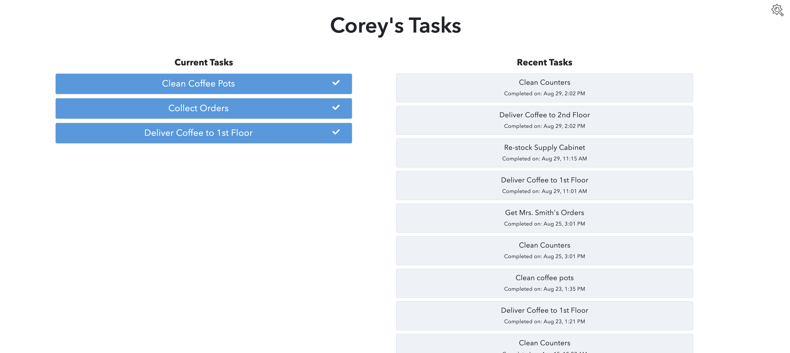

Slide 15
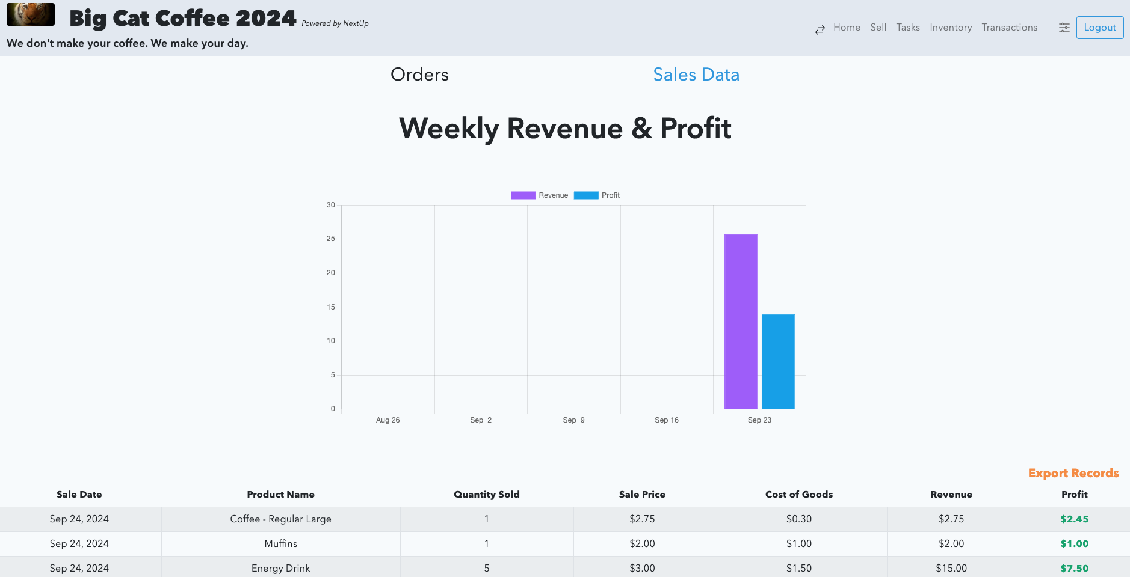

Slide 16
Thank you for attending!
Corey Fineran - corey.fineran@transitioncurriculum.com
Lindsay Zerull – lindsay.zerull@transitioncurriculum.com
TransitionCurriculum.com/conference

